Slide 1

Obtaining Texas Juvenile Records
by criminal defense practitioner

Slide 2
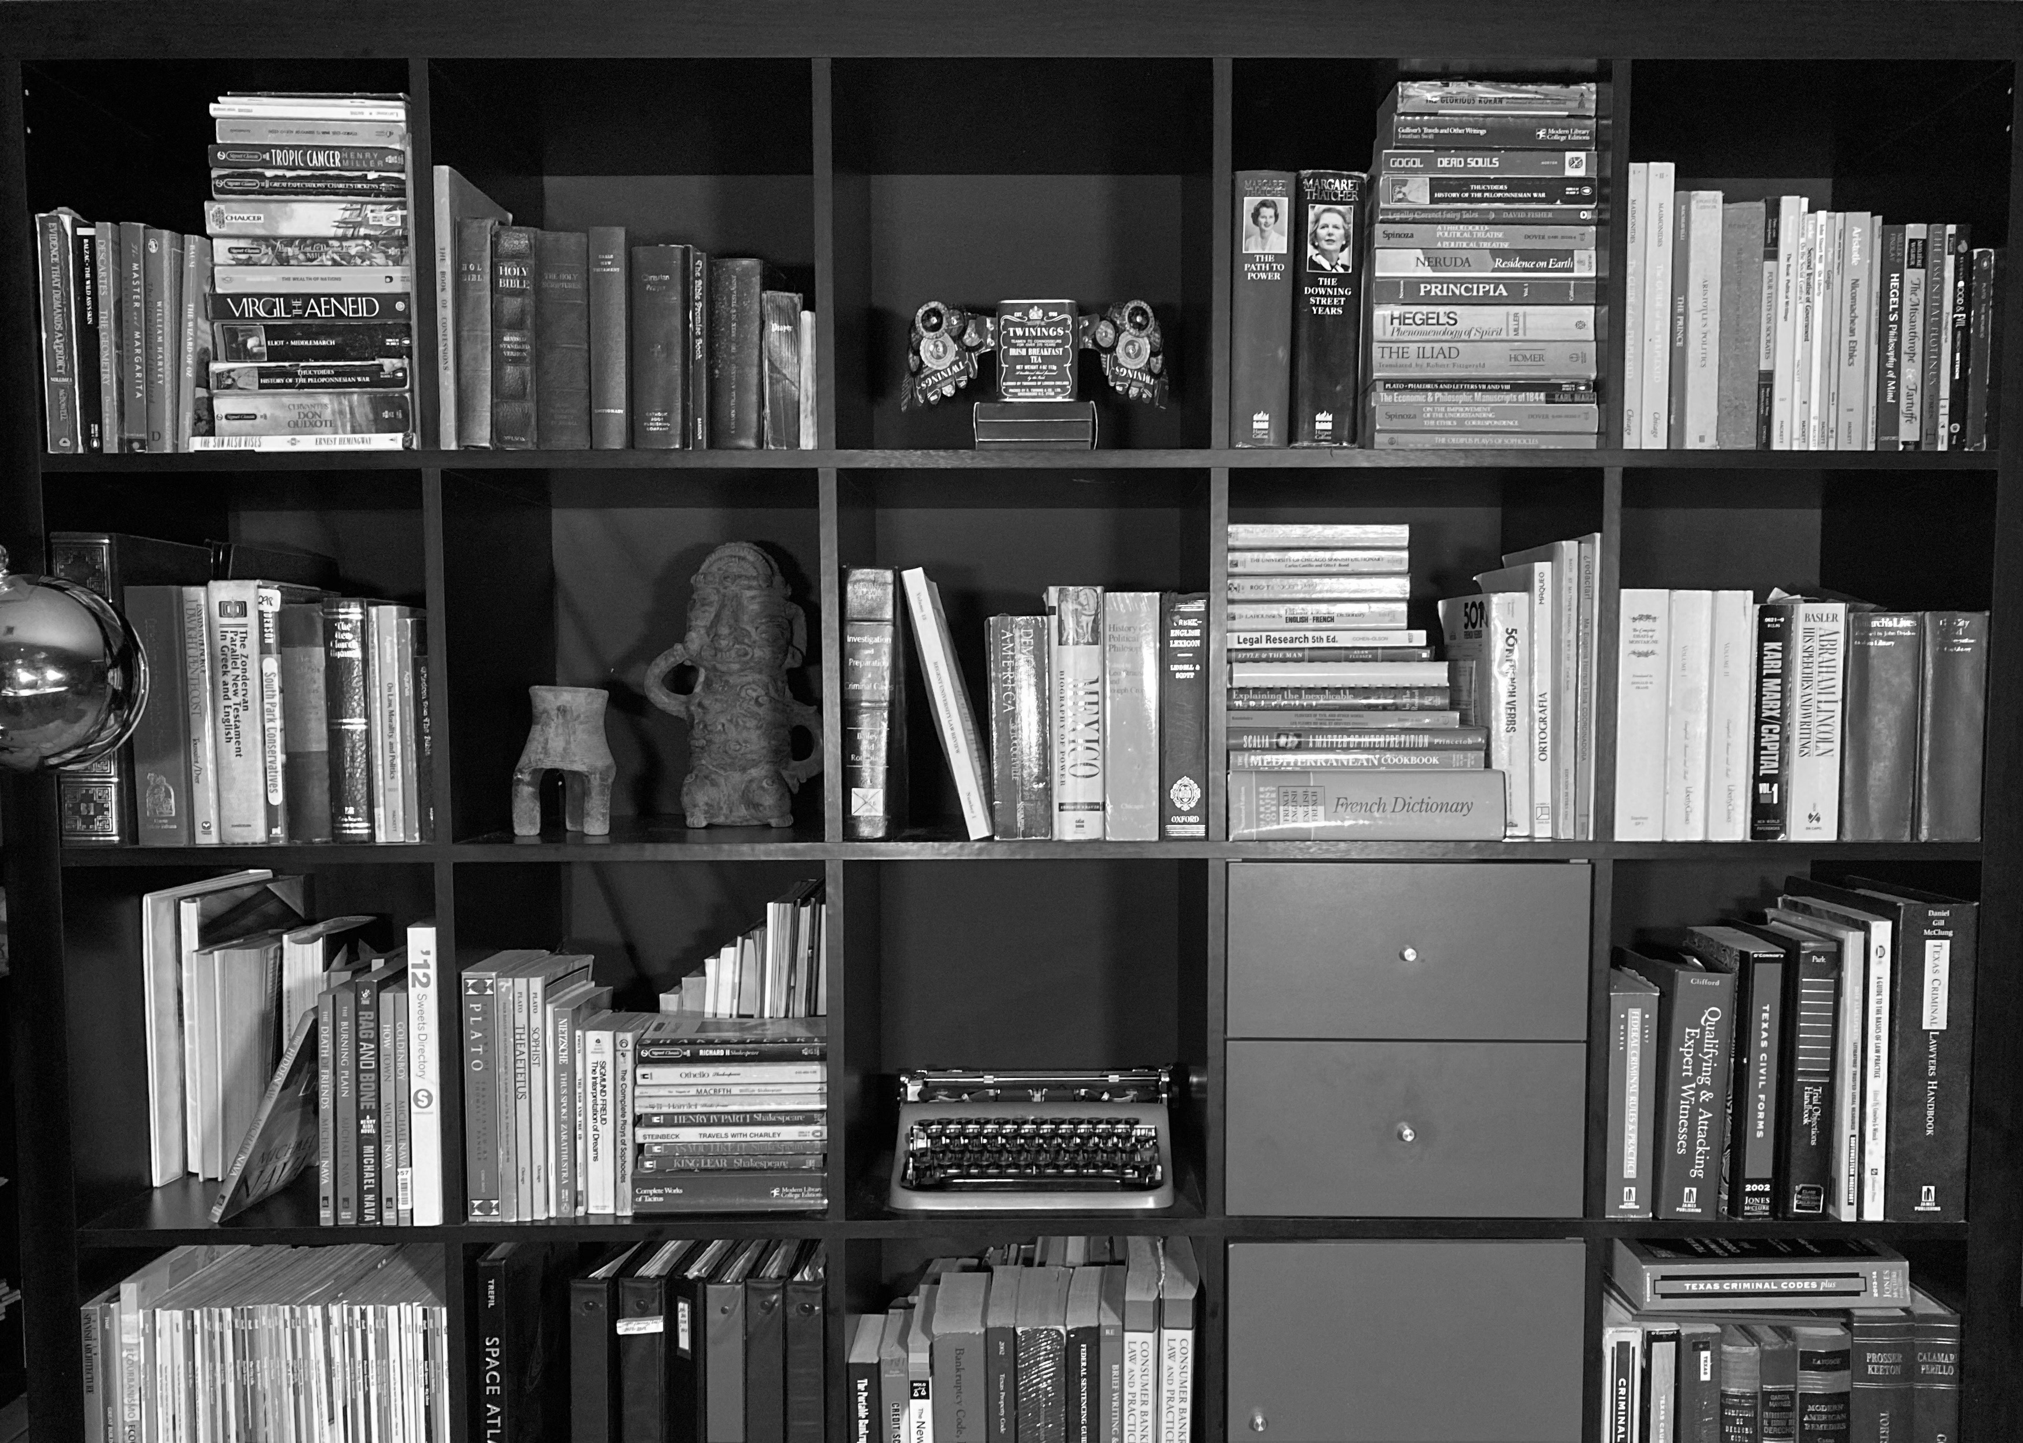
Lennard K. Whittaker, Attorney
P.O. Box 720876, McAllen, TX
956 821 9918
teksus@mac.com
www.whittaker.law
criminaltrialstrategist.com

Slide 3
You can find practice forms, motions & papers at:
www.whittaker.law/services-to-attorneys/
www.criminaltrialstrategist.com/services-to-attorneys/

Slide 4
Scenarios that led to this presentation
(Case 1) Interrogation of my client by Mission PD revealed a previous sexual case against my client (which could not be found in electronic search of District Clerk records).
(Case 2) The shooter seemed to get little law enforcement attention in initial discovery in an aggravated robbery case against my client.
(Case 3) Adolescent Accuser made outcry against uncle (my client) from juvenile detention intake
(Case 4) Research into Adolescent Accuser revealed a likely juvenile case.

Slide 5

Tx Family Code Ch. 58
Juvenile records are regulated and severely restricted.
Even within prosecution offices, juvenile records have restricted access.
Often, the records are sealed. When sealed even the indexes are to be erased of the juvenile record references.

Slide 6
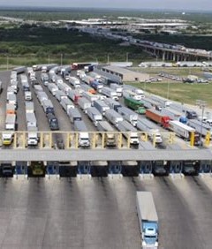
Client has right to his own juvenile records (Case 1)
Your client can access his own records, even if they are sealed.
Request can be made through the juvenile court, itself.
(Expect the prosecution office to know about your client’s request even if you do it ex parte.)

Slide 7

Client has right to his own juvenile records (Case 1)
If you can get the criminal ADA to join you, you can make a joint request of juvenile prosecution office, which can seek juvenile court approval.
(In Hidalgo County, HCDA juvenile & civil division tends to assist.)
One can seek an order to prosecution to access the juvenile records.

Slide 8
The value of client juvenile records
  The evaluations. Psycho-social, psycho-sexual & psychological. For your client mitigation or defense.
  The criminal ADA can peruse the information under 58.007(b)(5) & (g).
  Preparation for sentencing.

Slide 9

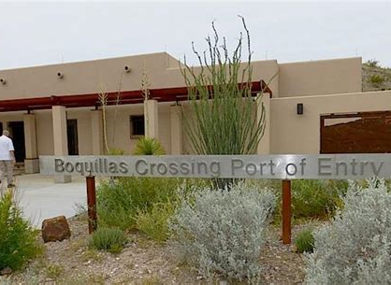
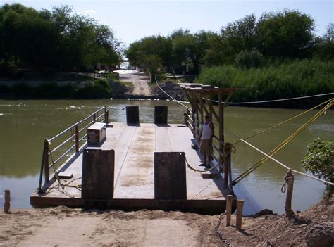

Slide 10
Legitimate Interest Exception
Tx Fam. Code 58.005(a)(7)
…with leave of the juvenile court, any other person, agency or institution having a legitimate interest in the proceeding or in the work of the court.
Tx Fam. Code 58.007(b)(5) has similar language
“Legitimate”, per Black’s, That which is lawful, legal, recognized by law, or according to law….

Slide 11
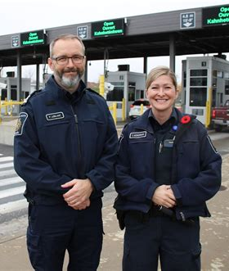
Pursuit of Juvenile Shooter records for an adult co-defendant Agg. Robbery (Case 2)
  Get criminal ADA to submit a joint request to the juvenile prosecution office for the records. (This is the most efficient option. HCDA juvenile prosecution prefers this method.)
  In Case 2, the criminal ADA conducted a joint request.
  Otherwise, motion practice is needed.

Slide 12
The value of co-perpetrator juvenile records
The evaluations.
The results of the juvenile process: supervision, dismissal, detention, findings, admissions, and implications.
Often, prosecution attempts to maximize culpability on older co-defendant. A review of the juvenile records of co-perpetrator might reveal the juvenile to be independent-minded or sentenced lightly.

Slide 13
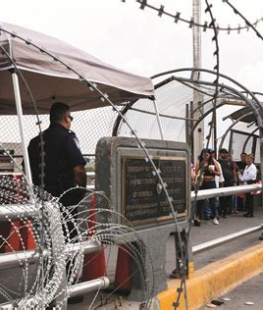
Pursuit of Adolescent Accuser juvenile records (Cases 3 & 4)
Get the criminal ADA to conduct a joint request.
The criminal ADA would not agree to requests in Cases 3 & 4.
If unable, try to get HCDA juvenile & civil division involvement. (Often the criminal prosecutors are misinformed on juvenile records regulations.)
Of course, motion practice might be required.

Slide 14

The Value of Accuser Juvenile Records
The evaluations. (Cases 3 & 4 revealed psychosis & hallucinogenic use.)
The findings.
The accusation context.

Slide 15
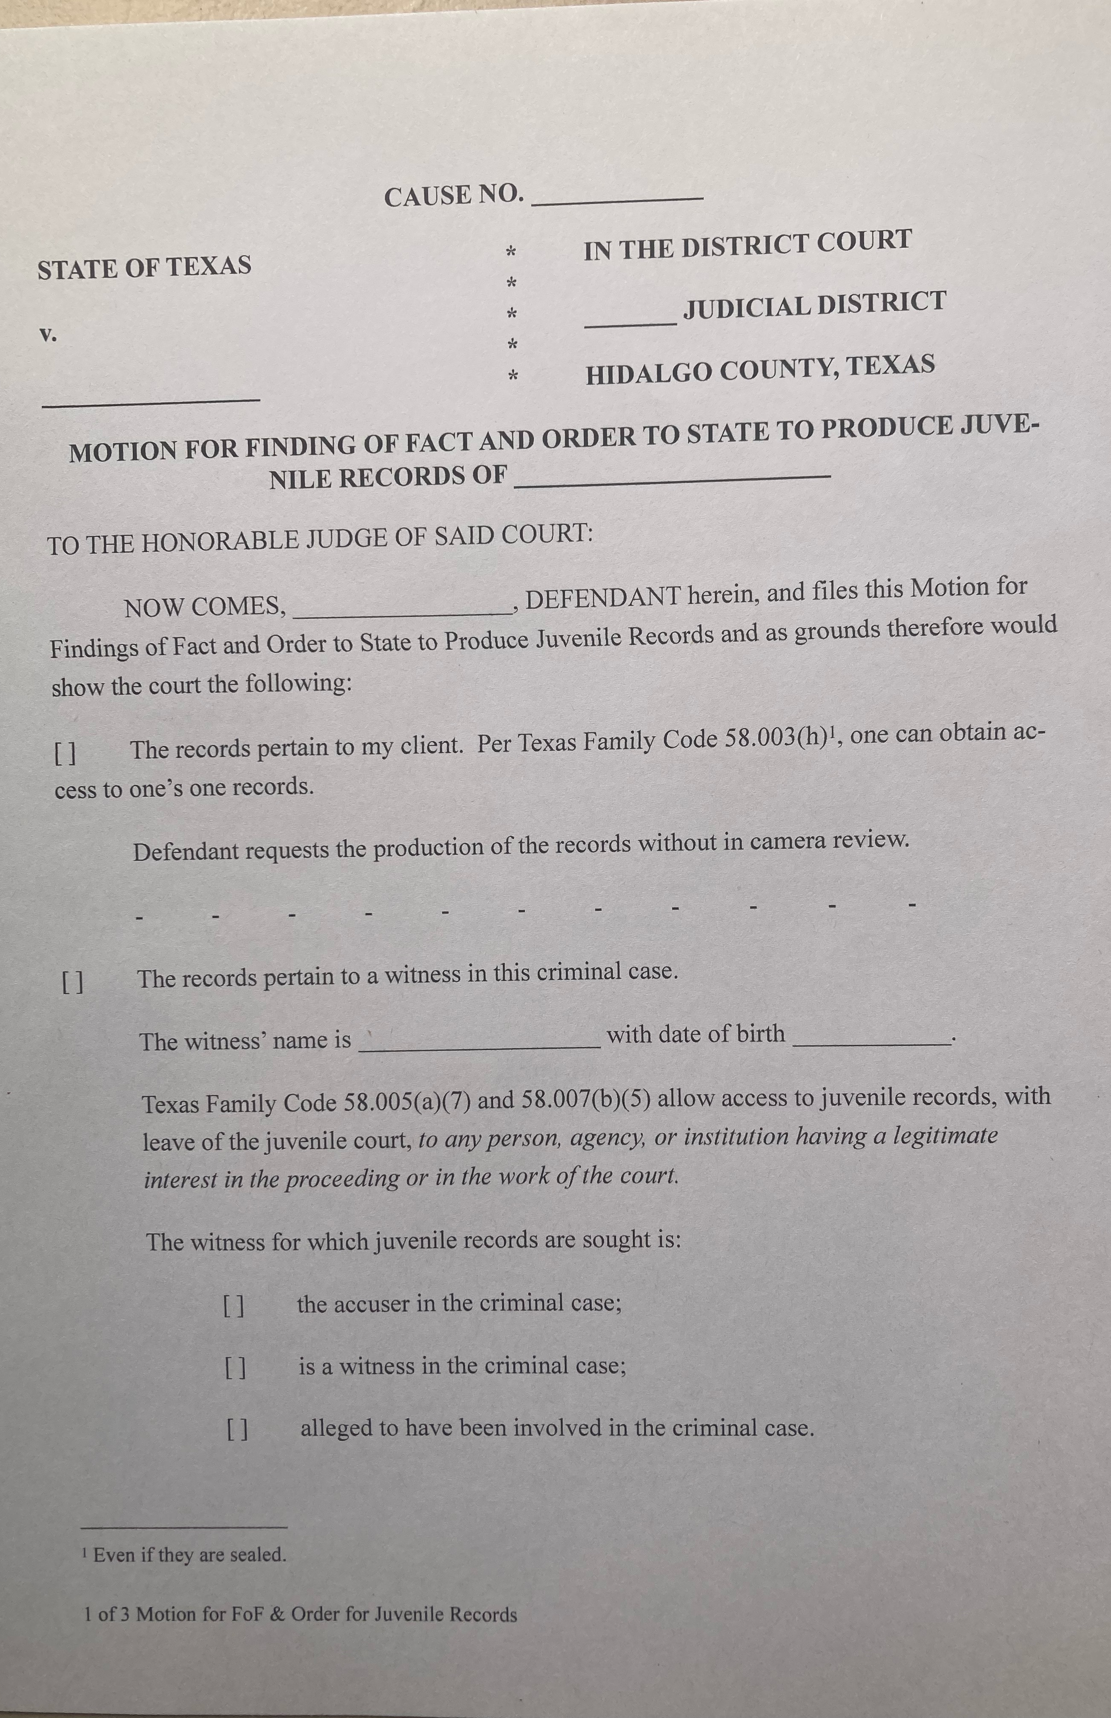
Material provided:
Motion for Findings of Fact & Order

Slide 16
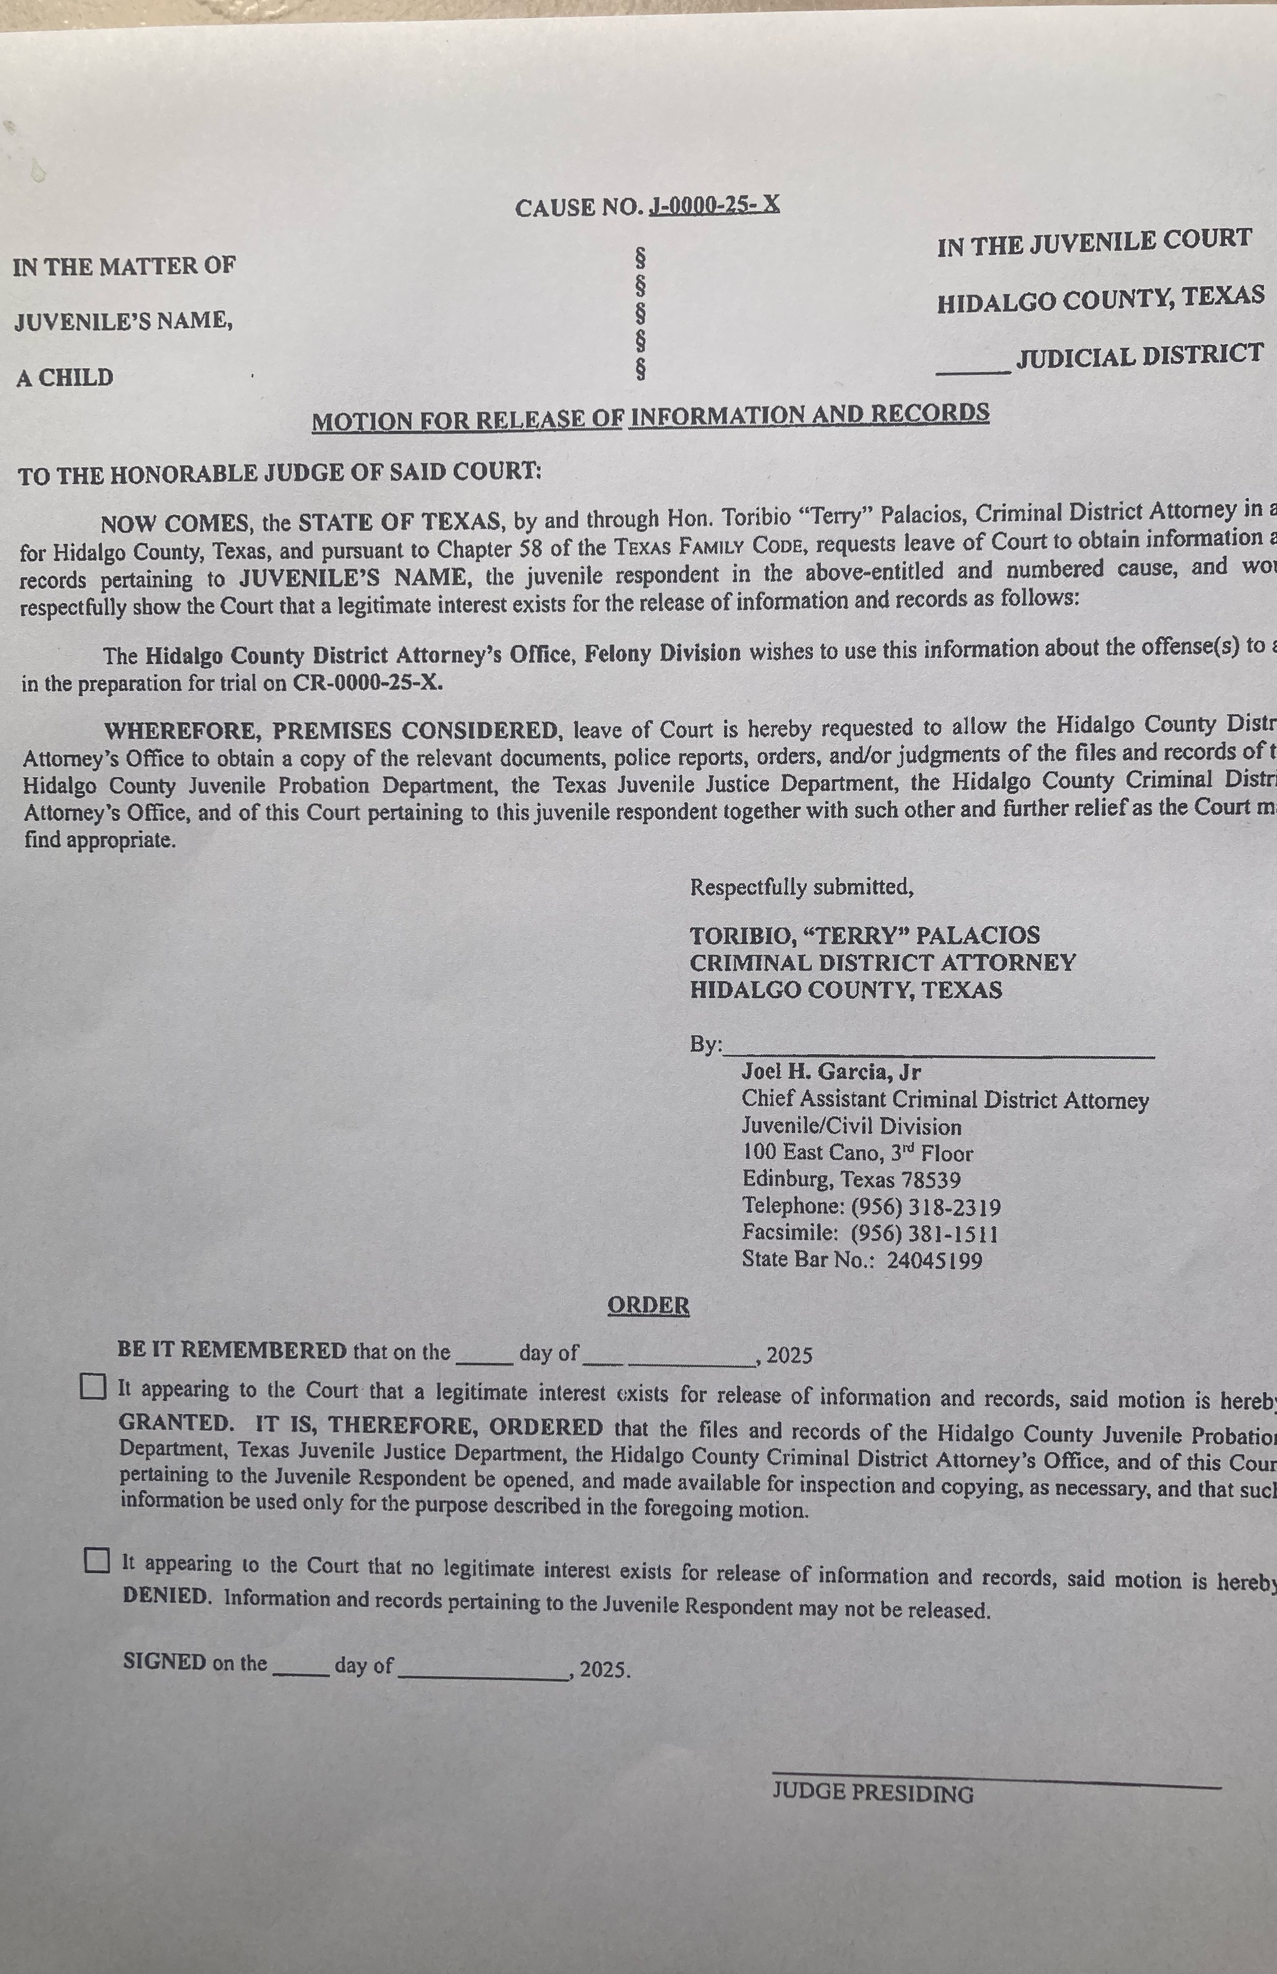
Material provided:
HCDA Motion for Release of Information and Records

Slide 17

Thanks to:
Hidalgo County District Attorney’s Office Juvenile & Civil Division

Slide 18
Steal, improve & modify practice forms & motions. Find papers & powerpoints.
www.whittaker.law/services-to-attorneys/
www.criminaltrialstrategist.com/services-to-attorneys/
www.crimin

