Slide 1
Out-of-State Criminal Subpoenas
5-step process (to get witness or material from another U.S. state)

Slide 2

Lennard K. Whittaker, Attorney
P.O. Box 720876, McAllen, TX
956 821 9918
teksus@mac.com
www.whittaker.law
criminaltrialstrategist.com

Slide 3
You can find practice forms, motions & papers at:
www.whittaker.law/services-to-attorneys/
www.criminaltrialstrategist.com/services-to-attorneys/

Slide 4
The Uniform Act
The Uniform Act to Secure the Attendance of Witnesses from Without a State in Criminal Proceedings (“Uniform Act”)
Concocted in 1931. Underwent changes. Held Constitutional in 1959.
Enacted in 50 states by 1977. Also, enacted in DC, Puerto Rico, USVI. Guam has a similar statute.

Slide 5
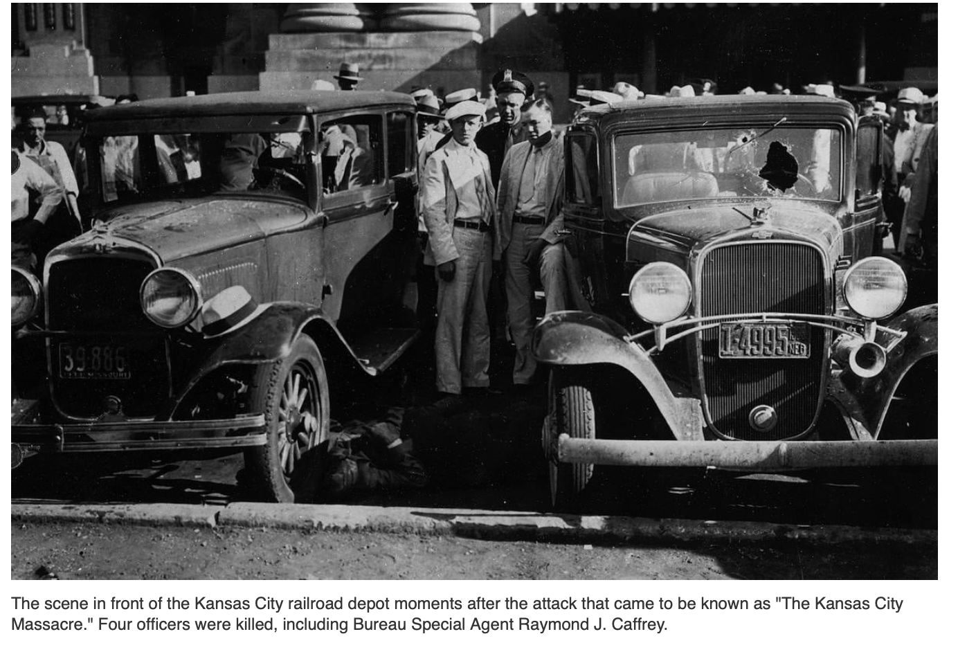

Slide 6
TxCCrP 24.28
Sec. 1 SHORT TITLE. This Act may be cited as the “Uniform Act to Secure the Attendance of Witnesses from Without the State in Criminal Proceedings.”

Slide 7
Determinations prior to starting this process
1. Assert possibility & necessity of Material Evidence
2. Get the address & other contact info (of the target of subpoena/summons)
3. Length of time witness is needed
4. Identify states through which witness must travel*
5. Identify possible witness protection issues*

Slide 8
*The Uniform Act requires & provides legal protection for the witness.
Identify if there are warrants or lawsuits awaiting service or execution along the witness’ travel route.
Select a travel route/method which avoids as many service or execution obstacles as possible.

Slide 9
5-Step Process
Estimate of time from filing for Certificate to obtaining witness/evidence: 3-4 months.
Use this process as a last resort, try to obtain the witness/evidence via request. (For example, a well-written QPO with a written request often gets the records. A redacted request letter & QPO is in the materials incorporated into the Certificate as an exhibit.)

Slide 10
5-Step Process
Step 1—Set up the structure of the process
Research both States’ acts. (Materials include NAAG reference chart for each state’s Uniform Act.) www.naag.org/uniform-act-to-secure-witness-reference-chart
Set up a facilitator/liaison office in the remote State in the exact jurisdiction of the Witness.
(Public Defenders & appointed counsel should request assistance of public defender offices in the target jurisdiction. Appointed counsel might need a letter of introduction from one’s local PD office. Retained counsel must likely hire counsel in the target jurisdiction.)

Slide 11

Facilitator/local counsel
You will need a liaison office in the target jurisdiction. Choose one who knows how to conduct the filing, service, and draft correct forms. If you are seeking records from a large institution, the facilitator/liaison might have experience with that exact institution.
Clarify the goals of summons to liaison. For example, if all that you need are records and a business records exception affidavit, inform the liaison.
If you are appointed or a public defender, Hidalgo County Public Defender will provide a letter of introduction should you choose to use a Public Defender office as liaison in the Sister State.

Slide 12
5-Step Process
Step 2-Request Certificate from Texas court
A. Draft/file the Motion with:
  1. Affidavits/statements to show materiality & necessity of witness/items (Suggestion: include a paper trail or clear description of attempts to obtain items by request.)
  2. Attach paper trail, copy of Texas’ Uniform Act, copy of the target jurisdiction’s Uniform Act, copy of each transit state’s Uniform Act, copy of Texas Reimbursement statute TxCCrP 35.27
  3. Trial setting* (Uniform Act mentions ‘trial.’ Be meticulous in using a ‘trial’ setting in the instruments & court file—even if there is an understanding that the ‘trial’ will convert into a pre-trial setting.)
  4. State the number of days witness will be needed for the intended ‘trial.’
  5. Provide intended plan for advance payment.

Slide 13
5-Step Process
Step 2-Request Certificate from Texas court
B. Get the Certificate signed & certified with a formal seal.
  1. Include a clear statement of materiality (why you need the witness, why this is not an undue hardship for witness, & prepare to advance travel/witness fees). Information provided in the Certificate is considered presumptively true in the other state’s court.
  2. Provide exact witness location & contact information.
  3. Include clear protection from process language for each state through which the witness must travel (and recommendation for taking witness into immediate custody to assure attendance, if so wanted.)

Slide 14
5-Step Process
Step 2-Request Certificate from Texas court
  Suggestion: Incorporate the following into the Certificate:
  the Motion and its exhibits/attachments
    indictment,
    order setting trial,
    document indicating your official involvement in the Texas criminal case

Slide 15
5-Step Process
Step 3—File Certificate in Sister State
1. Get with facilitator/liaison
a. Clarify goal of process (i.e., to obtain documents or testimony)
b. Provide a certified copy of Certificate w/attachments.
c. Determine if target jurisdiction allows for waiver of summons hearing.
2. Have facilitator file Motion/Request for Summons in target jurisdiction court & obtain a hearing date/time.

Slide 16
5-Step Process
Step 4-Sister State Hearing
  Liaison should file the state-appropriate petition for Summons of the witness based on the Certificate.
  Hearing(s) are to determine materiality, necessity, & possible undue burden
  A. Determine if you will need a pro hac vice appearance & if one can appear remotely. (Most likely no appearance out of state by you will be required nor useful. A well-chosen liaison can handle appearances, generally.)

Slide 17
5-Step Process
Step 4-Sister State Hearing
B. Sister State court must find:
  1. Witness is material & necessary
  2. No undue hardship to witness
  3. Expressed legal protection for witness in each state witness must travel.
  4. Issue subpoena/summons w/Certificate to witness.

Slide 18
5-Step Process
Step 5-Travel & Expense
Arrange Travel & Expenses
TxCCrP 35.27 provides for State reimbursement of nonresident witnesses. Sec. 8 allows indigent defendant to access Comptroller funds for advance or reimbursement.
The language of TxCCrP 35.27 seems so inclusive that witness expenses in retained cases might have some reimbursement from Texas Comptroller.

Slide 19

Thanks to:
Hidalgo County Public Defender
Minnesota Public Defender (State, 3d Judicial District, & 5th Judicial District)

Slide 20
Steal, improve & modify practice forms & motions. Find papers & powerpoints.
www.whittaker.law/services-to-attorneys/
www.criminaltrialstrategist.com/services-to-attorneys/
www.crimin

