Slide 1
Investigation before Formalization of Charges
When does a Texas Search Warrant affidavit become public.
How does one inspect it.

Slide 2

Lennard K. Whittaker, Attorney
P.O. Box 720876, McAllen, TX
956 821 9918
teksus@mac.com
www.whittaker.law
criminaltrialstrategist.com

Slide 3
Why is a search warrant affidavit important prior to indictment?
To know what convinced a judge to authorize the violation of someone’s rights…albeit her purse, his computer, someone’s phone, home or bodily orifices.
To have an insight on the state of an investigation.
To prepare client for next aspect of case…this is especially important for professionals, like teachers, who have union/employment issues prior to formalized charges.

Slide 4
Generally, Search Warrants and the affidavits upon which they are based become public information upon search warrant execution. (TxCCrP 18.01(b))

Slide 5
Sealed Texas Search Warrant affidavit becomes public information on 31st or 61st day after search warrant execution.
(TxCCrP 18.011)
If an attorney representing the State in felonies timely requests & seal is ordered, the affidavit remains non-public until the 31st day after search warrant.
If an attorney representing the State in felonies makes a timely seal extension, the affidavit remains non-public until the 61st day. (TxCCrP 18.001(b))
Sealed Search Warrant may not prohibit disclosure of information relating to warrant, return, inventory nor right of Defendant to discover contents of affidavit. (TxCCrP 18.001(d))

Slide 6
Practice Note: Most search warrants issued in Hidalgo County do not benefit from the participation of ANY State attorney. Therefore, most search warrant affidavits are public upon warrant execution.

Slide 7
Locate the Search Warrant affidavit
“…the magistrate’s clerk shall make a copy of the affidavit available for public inspection in the clerk’s office during normal business hours.” (TxCCrP 18.01(b))

Slide 8
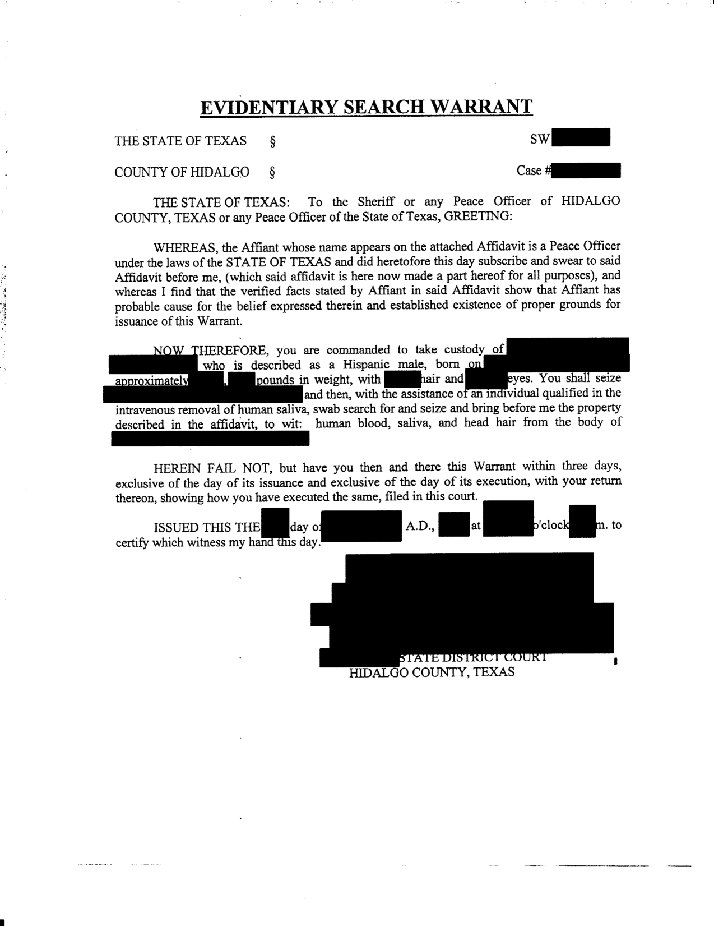
Magistrate’s signature* must be on the warrant. The warrant & inventory of seizure is usually given to the human target or left at search site.

Slide 9
Hidalgo County issues with locating magistrate that issued search warrant.
As most search warrants and affidavits are drafted by investigators via copy/paste commands, the issuing court might be incorrect.
Also, investigators are largely unadvised by the DA’s office. Sometimes they go from court office to court office in search of a judge.
And the magistrate signature might be illegible and unfamiliar.

Slide 10
Each magistrates’ situation, record-keeping, & processes might differ…even amongst district judges in the same courthouse.

Slide 11
If the magistrate is the 370th…
  His staff keeps electronic copies.

Slide 12
If the magistrate is the 398th…
His staff states that it has a copy of search warrant materials that came through the office.
However, Judge Vasquez is known to sign warrants away from the office. (He stated that he tells applicants to provide the copies to his office.)
To comply with a written request to inspect an affidavit, staff had to track down an investigator to provide the document(s).
My request was emailed to Judge Vasquez directly.

Slide 13
If the magistrate turns out to be auxiliary court…
The legibility and familiarity of the signature might be a factor in identifying the magistrate.
The magistrate is likely on a rotation…on for a week…off for 3 or 4 weeks.
Court staff keeps a physical copy of the affidavit, return, & inventory.
When I submitted a request for inspection to a magistrate, the request was left unread & envelope unopened on the grounds that it was a violation of TxDRPC 3.05 (on ex parte communication). It was emailed to magistrate & ADA with no response.

Slide 14
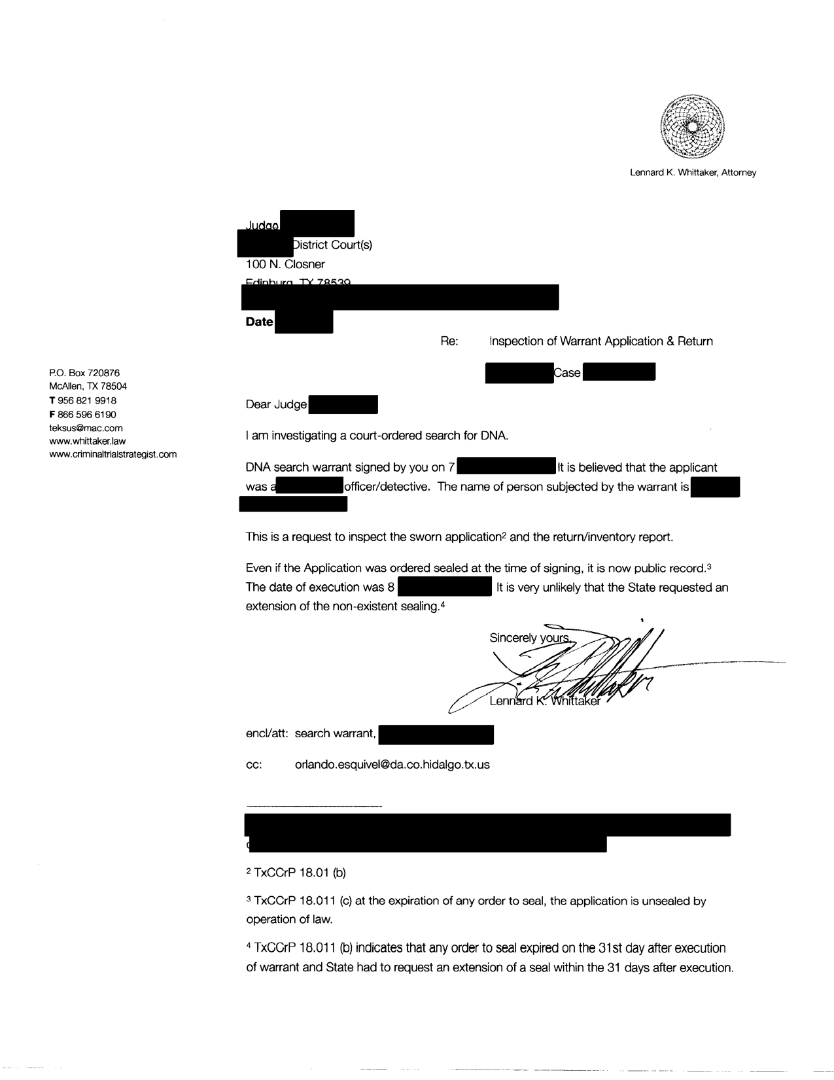
Request to Inspect…preferably in writing.
Emailing a request letter to magistrate or clerk is probably preferred. (It can be encrypted, forwarded easily by personnel, and serves as a record.)

Slide 15
Include a DA or investigator in your request at your discretion.
Note if you represent the targeted person, mention the policy implications of TxCCrP 18.011(d) regarding the right of Defendant.
Follow through with the request. Be considerate, it is a process most court staff don’t do often.

Slide 16
If the magistrate denies your right to inspect a public document
Three options:
  Educate the magistrate. Perhaps, by calling on a senior judge—-estimated cost a Starbucks coffee and/or political favor
  Mandamus—-estimated cost $7000
  the Press—-free*
  *Bring the press to your endeavor with great care & caution. Sunshine & publicity are great disinfectants, but they can destroy careers and affect jury pools.

Slide 17
Steal, improve & modify practice forms & motions. Find papers & powerpoints.
www.whittaker.law/services-to-attorneys/
www.criminaltrialstrategist.com/services-to-attorneys/
www.crimin

Slide 18
You can find practice forms, motions & papers at:
www.whittaker.law/services-to-attorneys/
www.criminaltrialstrategist.com/services-to-attorneys/

